Slide 1


Network protocols & security
24EC2210
Topic:
Introduction to Security
Session - 33

Slide 2
Introduction to Security
Security:
Ensuring the (secrecy) confidentiality, data integrity and availability of components of computer system.
1. Network security – measures to protect data during their transmission
2. Internet security - measures to protect data during their transmission over a collection of interconnected networks
3. Computer security – Computer security, also called cybersecurity, is the protection of computer systems and information from harm, theft, and unauthorized use.

Slide 3
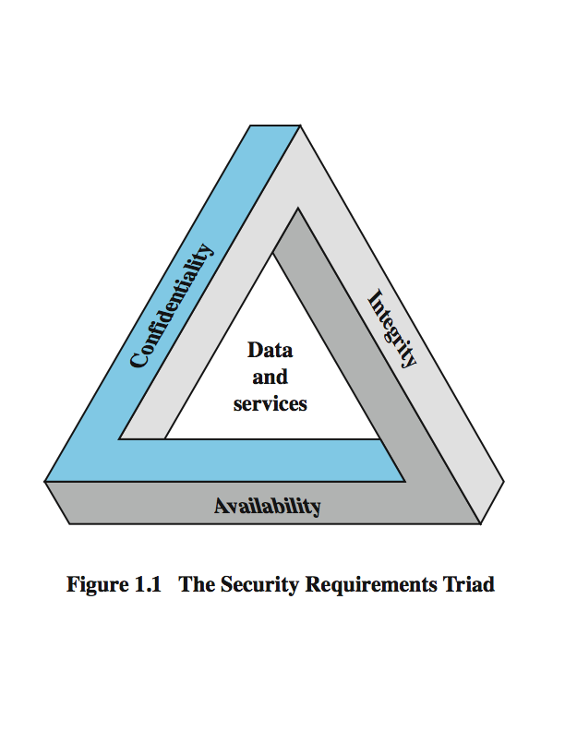
Key Security Concepts
Authentication
Non-repudiation

Slide 4
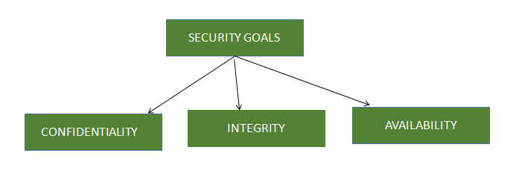
Security Goals
Confidentiality, data integrity and availability are the Security goals to protect computer assets from human errors, natural disasters, physical and electronic maliciousness.

Slide 5
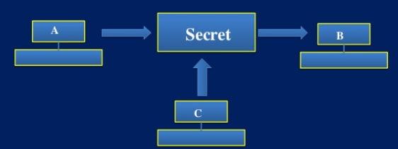
Confidentiality
Assures that private or confidential information is not made available or disclosed to unauthorized individuals
Specifies that only the sender and the intended recipient(s) should be able to access the contents of a message.
Another user C gets access to this message, which is not desired and therefore, defeats the purpose of confidentiality.

Slide 6
Integrity
Integrity deals with making sure that things are not changed from their true form. Attacks against integrity are those that try and modify something that’s likely going to be depended on later.
Examples include changing prices in an ecommerce database, or changing someone’s pay rate on a spreadsheet.

Slide 7
Availability
Assures that systems work promptly and service is not denied to authorized users.
Ensuring that authorized parties are not denied access to information and resources.

Slide 8
Authentication
Authentication is the process of verifying the identity of user or information.
User authentication is the process of verifying the identity of user when that user logs into a computer system.
The main objective of authentication is to allow authorized users to access the computer and to deny access to the unauthorized users.

Slide 9
Non-repudiation
Non-repudiation is the assurance that someone cannot deny something.
It does not allow the sender of a message to refuse the claim of not sending that message.

Slide 10
Security Attacks

Slide 11
Levels of Impact
We can define 3 levels of impact from a security attack
Low - The loss is minor
Moderate - The loss is serious
High - The loss severe

Slide 12
Security Attacks
Any action that compromises the security of information owned by an organization.
Types
- Passive Attack
Just to obtain information. Does not Modify or harm the system.
- Active Attack
May Change the Data and harm the system.

Slide 13
Passive Attacks
Passive attacks are in the nature of eavesdropping on, or monitoring of, transmissions.
The goal of the opponent is to obtain information that is being transmitted.
Two types of passive attacks
- release of message contents
- traffic analysis

Slide 14
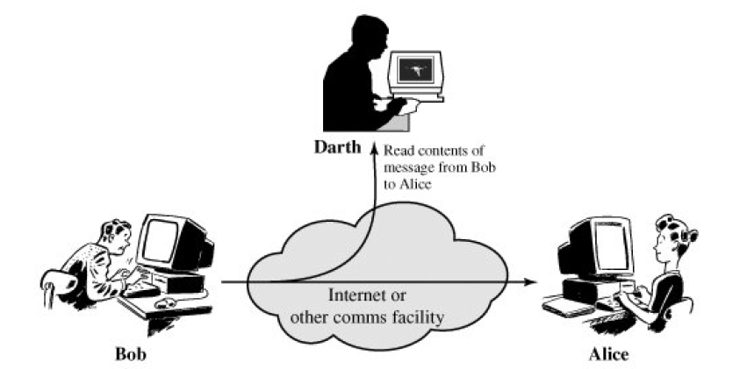
Passive Attack (a) Release of message Contents
This attacker happens when confidential user data are released publicly over the network.

Slide 15
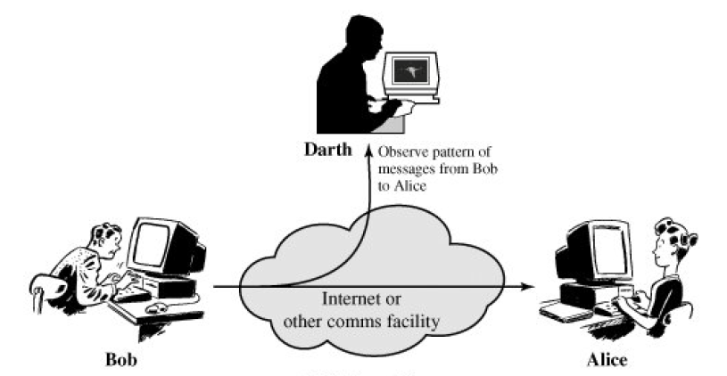
Passive Attack (b) Traffic analysis
Take SSH(Secure Socket Shell), for example. Every time you press a key on your keyboard, SSH sends a separate IP packet. By analyzing these packets, an attacker can distinguish the timing between key presses. They can then use this information then, for example, to guess users' password lengths.

Slide 16
Active Attacks
Active attacks involve some modification of the data stream or the creation of a false stream
It can be subdivided into four categories:
- masquerade
- replay
- modification of messages
- denial of service.

Slide 17
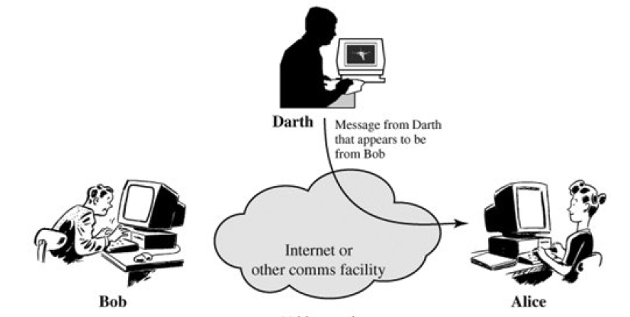
Active Attacks (a) Masquerade
A masquerade attack is an online attack in which the attacker masquerades as a legitimate user to gain access to a device.

Slide 18
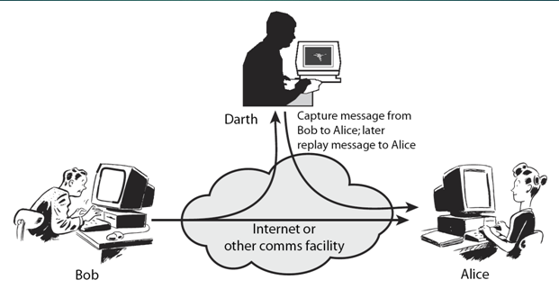
Active Attacks (b) Replay

Slide 19
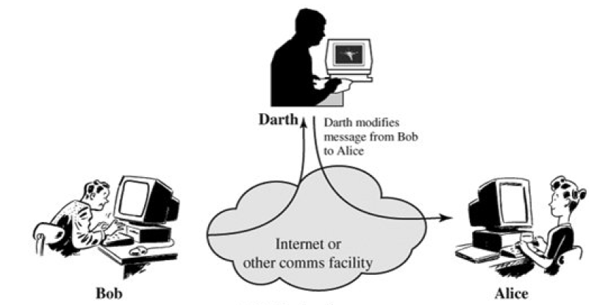
Active Attacks (c) Modification of messages

Slide 20
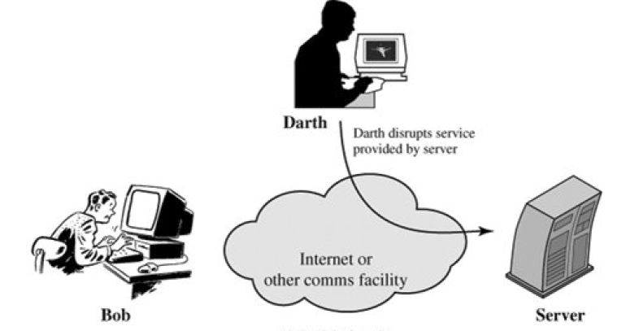
Active Attacks (d) Denial of service
A Denial-of-Service (DoS) attack is an attack meant to shut down a machine or network, making it inaccessible to its intended users.

